Slide 1

Task: Tableau Project
Project On: ICC Men T20 World Cup 2024 Full Scorecards & Stats
Submitted by : Puneeth Vadlamudi
Registration Number : 12212244
Roll No : 16
Section : K22BW
Submitted to : Mr. Vikas Mangotra (31488)

Slide 2
About the project
I conducted an analysis of the ICC T20 World Cup to identify the top-performing batsmen who scored the most runs and the bowlers who took the highest number of wickets. Additionally, I evaluated which team excelled in both batting and bowling. I also examined the winning margins of the teams to understand their dominance in the matches.

Slide 3
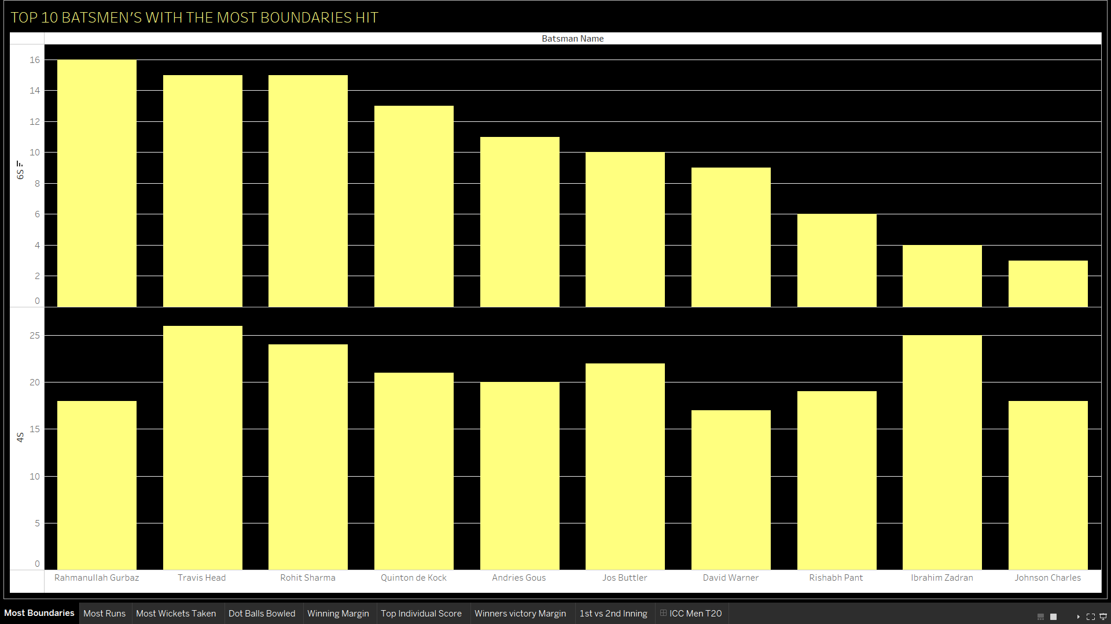
Chart1: Top 10 Batsmen’s with the most Boundary Hit

Slide 4
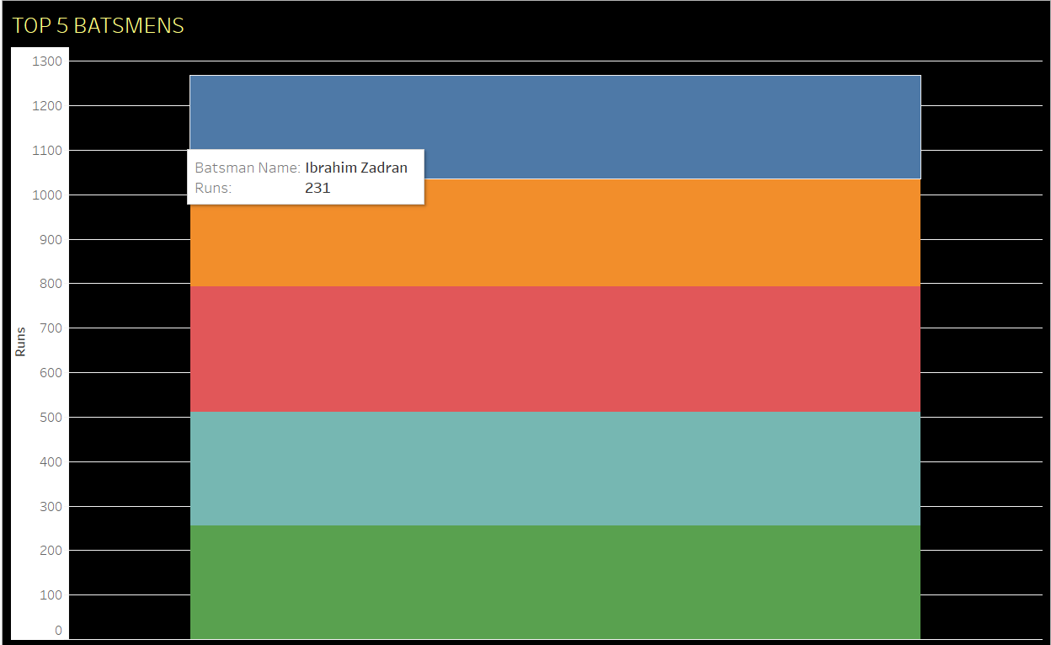
Chart2: Top 5 Batsmen’s

Slide 5
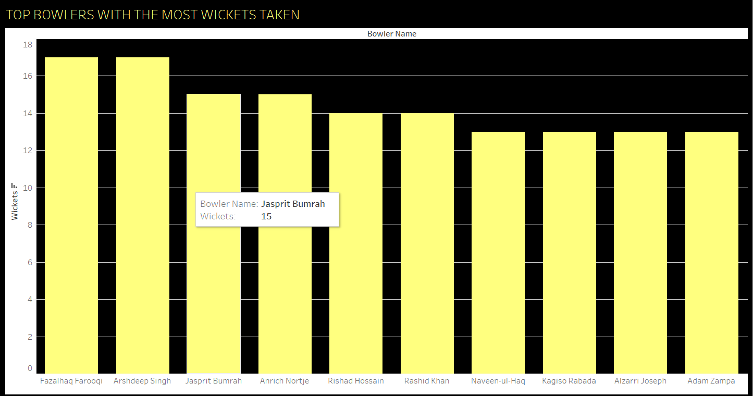
Chart3: Top Bowlers with the most wickets taken

Slide 6
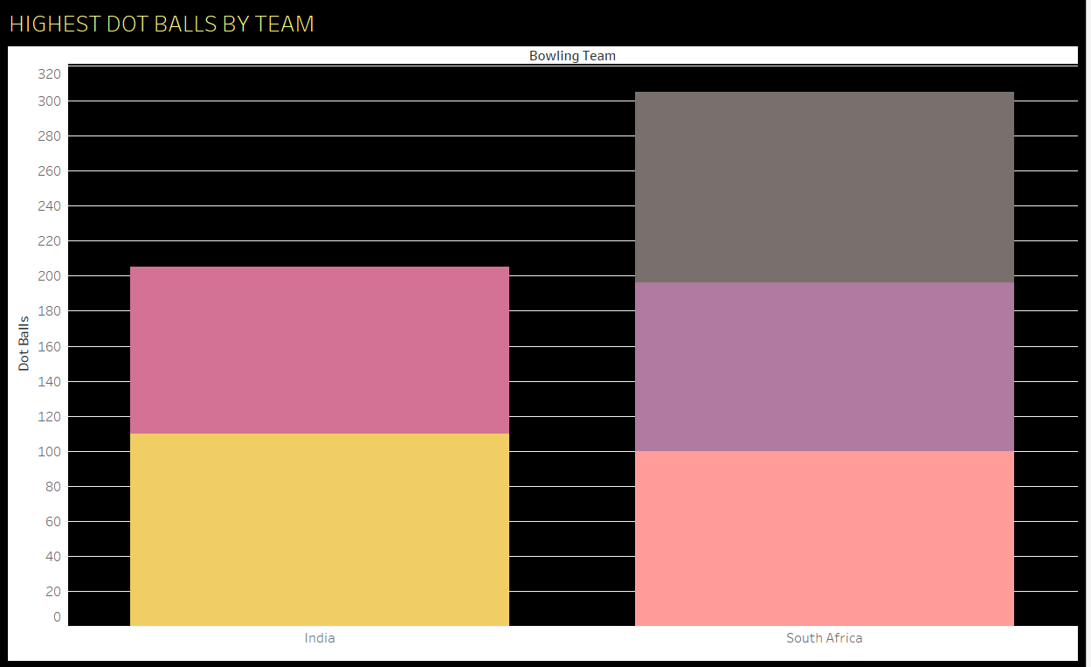
Chart4: Highest Dot Balls Bowled

Slide 7
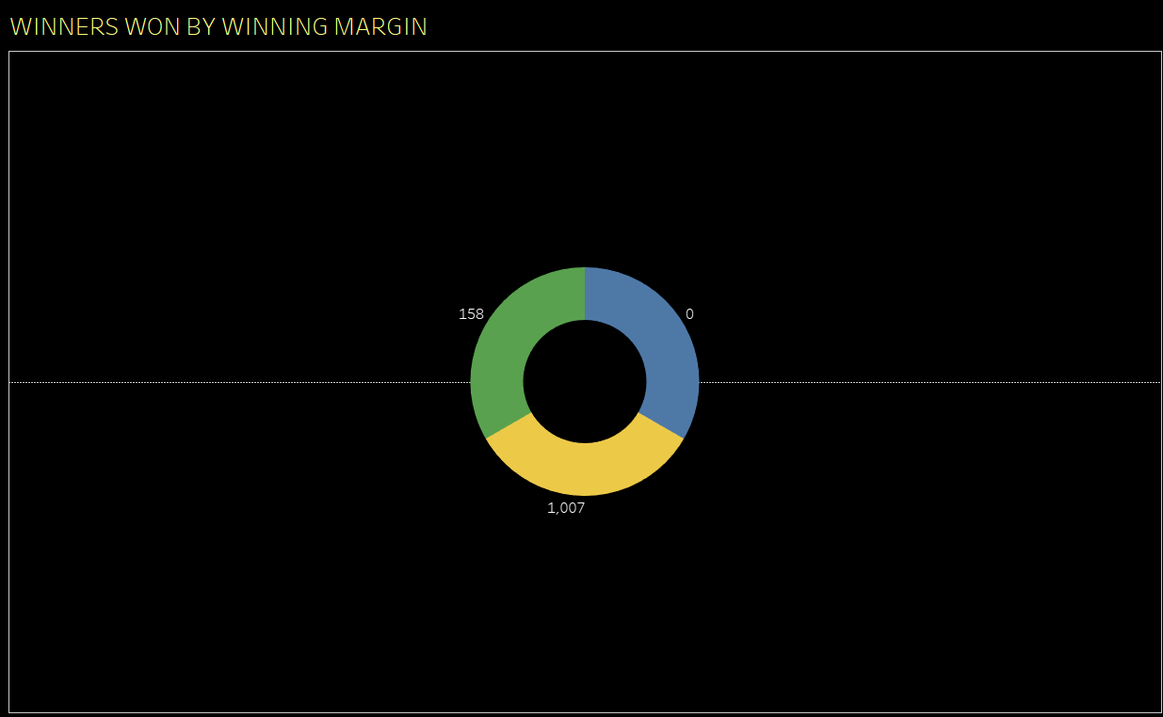
Chart5: Winners Won By Winning Margin

Slide 8
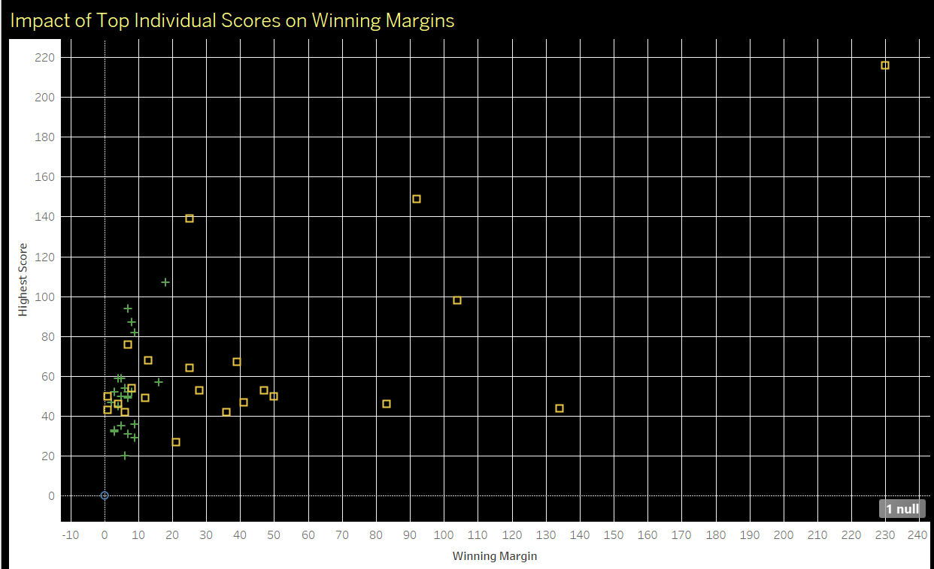
Chart6: Impact of Top Individual Scores on Winning Margins

Slide 9
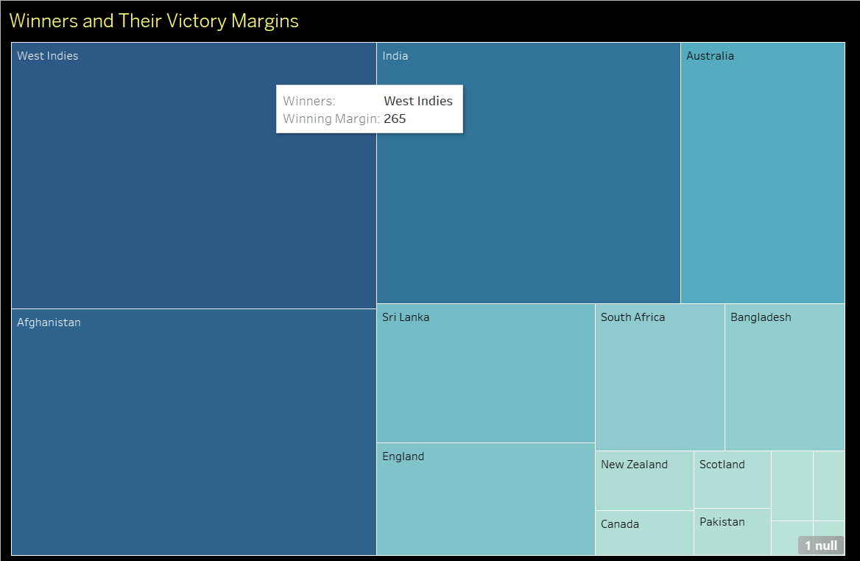
Chart7: Winners and Their Victory Margin

Slide 10
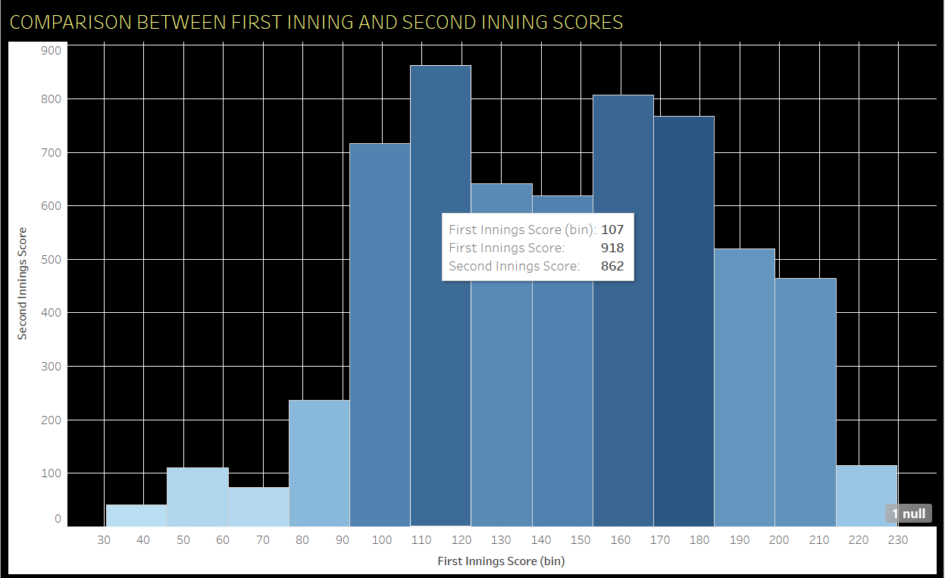
Chart8: Comparison Between First Inning and Second Inning

Slide 11
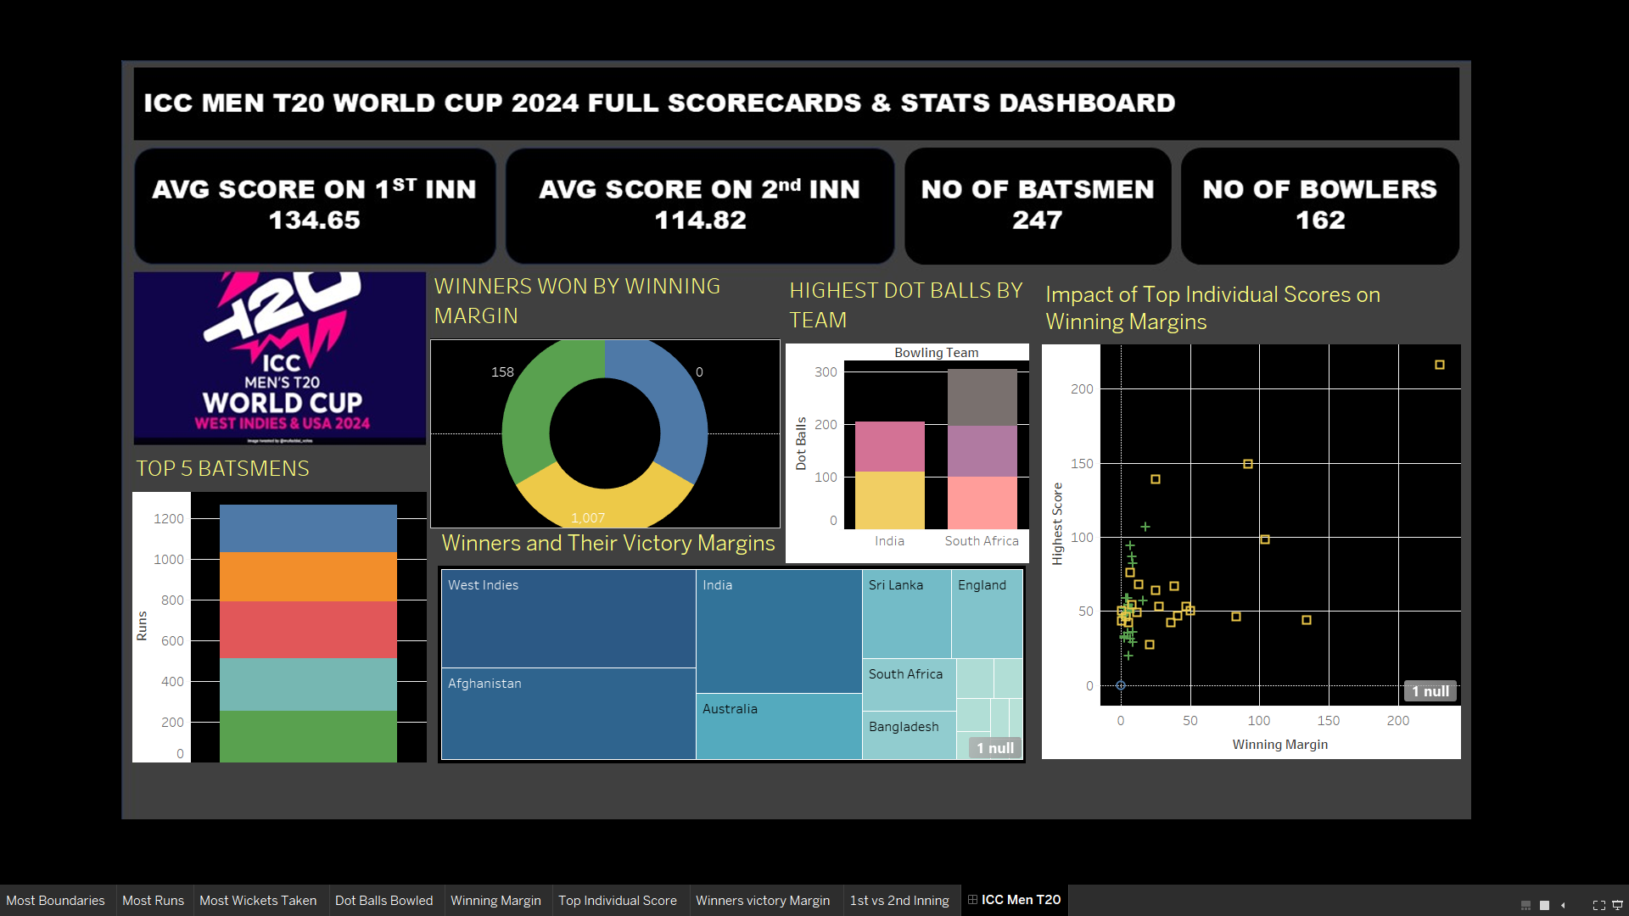

Slide 12
Objectives These objectives ensure a comprehensive analysis of both individual and team performances while drawing actionable insights for players, teams, and fans.
Conclusion
The data is useful for analyzing the best-performing batsmen, which can be highly beneficial for betting apps to adjust their odds. It is also valuable for team coaches to identify areas of improvement and plan focused practice sessions effectively.

